Slide 1
Group 3 Random Access Procedure in MAC Specification 38.321 Mentored by :-Abhijeet Sir
Role: Manages initial connection establishment and channel access. Significance: Ensures efficient and fair access to the communication channel.

Slide 2
Contents
Introduction to MAC Layer
Overview of Random Access Procedure
Random Access call flow
Role of Random Access Procedure in MAC
Significance of Random Access Procedure
Type of Random Access Procedures
Key Challenges and solutions
Real-World Applications
Code
Conclusion

Slide 3
Presented By:-
Bhakti S
Ranjita Karadad
Ritesh Mishra
Vaidehi Shailendra Bhosale
Vanaja Dukka
Vivek Kumar
Yash Pramod Gulhane
Yengala Dharmendra Kumar Reddy

Slide 4
Introduction to MAC layer
The MAC(Medium Access Control) layer is a crucial part of wireless communication systems, play a important role in 5G wireless communication.
It helps in managing how transmitting and receiving the data over the air between the UE(like a mobile phone) and network.
MAC layer is lowest layer of Layer 2. It present between the RLC and Physical layer.
The Medium Access Control (MAC) layer is responsible for managing protocol access to the physical network medium.
Function of MAC layer like
-Mapping between logical channels and physical channels
- Multiplexing of MAC SDUs

Slide 5
-DE multiplexing of MAC SDUs
-Error correction through HARQ
-Random Access Control
The MAC layer is like a manager that:-
- Keeps devices from talking over each other
- Assigns resources to devices
- Prioritizes important data
- Ensures data is delivered correctly
- Supports different types of services
Importance of MAC Layer are:-
-Low Latency
-High speed Data Transmission
-QoS(Quality of Service
-Security
-Ultra-Reliable Communication

Slide 6
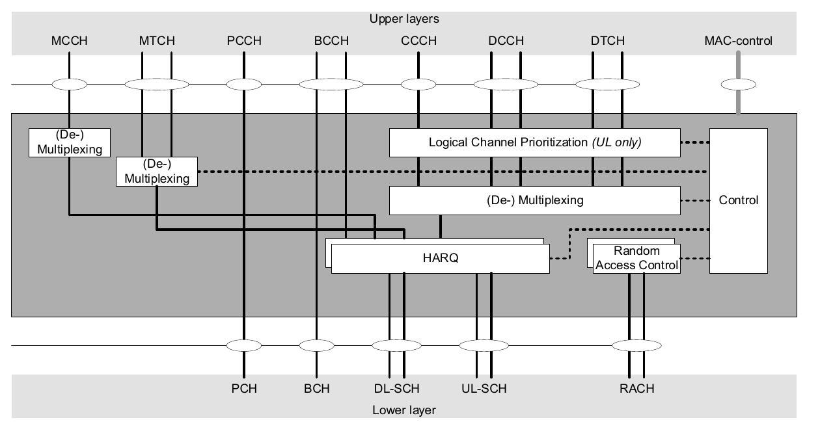
Diagram of MAC Layer

Slide 7
Overview of Random Access Procedure
The Random Access Procedure is a method used by device (UE) to initiate communication with the network, especially when they need to connect to network for the first time or re-establish a connection.
It’s a critical component of the 5G NR (New Radio) protocol.
RAP is like a "doorbell" that devices ring to access the 5G network. The network responds, and they establish a secure connection.
Random Access Procedure (RAP) in 5G is a process that allows devices to:
-Access the network for the first time
-Re-establish a connection after a disruption
-Handover to a new cell

Slide 8
Random Access call flow
Random Access Procedure call flow in 5G:-
Random Access Call Flow refers to the process by which a device (UE) establishes a connection with a cellular network (gNodeB) in a 5G. This procedure is used during initial access, handovers, and other scenarios where a UE needs to establish or re-establish a connection.
The procedure consists of four primary steps (or messages): MSG1, MSG2, MSG3, and MSG4.
MSG1:- Random Access Preamble (RACH Preamble):-UE send a preamble to the network.
*Content:-
-Random Access Preamble:-The UE selects a sequence from a set of predefined sequences to indicate its intention to access the network.
-Timing Advance(TA):-The network estimates the timing advance needed for the UE when it receives the preamble, making the Timing Advance (TA) implicitly included.

Slide 9
.
*How it’s sent(Transmission):
The UE sends the preamble on the Physical Random Access Channel (PRACH).
The preamble doesn't include any explicit UE identity.
*Why it’s sent(Purpose):
It starts the random access procedure and signals the UE’s intention to access the network.
It helps the network estimate the UE’s timing advance for synchronization purposes.
2. MSG2: Random Access Response(RAR):-Network responds with timing advance, uplink grant, and temporary identity.
*Content:
- Timing Advance Command (TAC): Adjusts the timing for the UE.
Temporary C-RNTI (Cell Radio Network Temporary Identifier): A temporary identifier given to the UE.
Grant for MSG3: Allocates uplink resources for the UE to send MSG3.
RAR identifier: Identifies the preamble used by the UE to ensure the response matches the initiating preamble.

Slide 10
*Message Transmission: - The network sends this message on the Physical Downlink Shared Channel (PDSCH), along with a Downlink Control Information (DCI) message on the Physical Downlink Control Channel (PDCCH).
*Message Purpose:-The RAR acknowledges the receipt of the preamble and provides the necessary resources and synchronization information to the UE for the next message.
3.MSG3:-RRC Connection Request/RRC Connection Resume/ RRC Connection Re-establishment Request:-UE sends its identity and requests connection or resume.
*Content:-
- UE Identity: This is a temporary identity (C-RNTI) or a permanent identity (like a Globally Unique Temporary Identifier, GUTI) used to identify the UE to the network.
RRC Layer Message: This contains the Radio Resource Control (RRC) signaling message, such as an RRC Connection Request.
- NAS PDU (Optional): This includes Non-Access Stratum Protocol Data Unit, which can include an authentication request, service request, and more.
- UE Capabilities: This provides information about the UE’s capabilities. It is optional and depends on the context.

Slide 11
*Transmission:
The UE sends this on the Physical Uplink Shared Channel (PUSCH) using the uplink grant provided in MSG2.
*Purpose:
It establishes or resumes the connection between the UE and the network.
It provides the network with the UE’s identity and other essential information.
4.MSG4:RRC Connection Setup/RRC Connection Resume/ RRC Connection Re-establishment:-Network finalizes the connection setup and provides configuration.
*Content:
RRC Configuration: Explains the radio resources and configuration parameters that the UE should use.
C-RNTI Assignment: The network may confirm or change the C-RNTI for the UE.
- Security Parameters: Gives the necessary information for the UE to set up secure communications (such as keys).
*Transmission: - Sent by the network on the PDSCH.

Slide 12
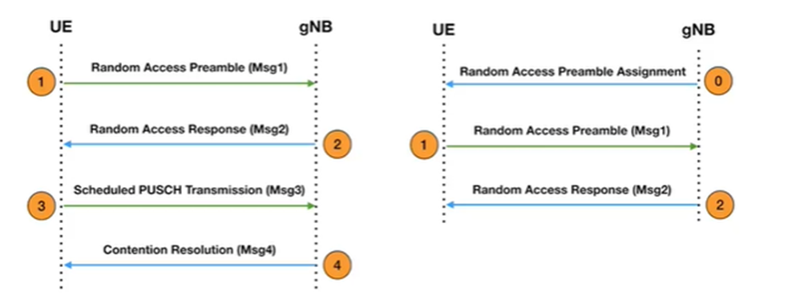
*Purpose:
Completes the random access procedure by setting up the RRC connection between the UE and the network.
Sets up the UE with the necessary parameters for ongoing communication.
*This process ensures that the UE can establish a synchronized and secure connection with the network efficiently.

Slide 13
Role of Random access Procedure in MAC
Connection Establishment:- The random access procedure facilitates the initial connection establishment between devices, enabling them to communicate with each other.
Channel Access management:-The RAP determines which device has the right to transmit data at a given time, preventing collisions and ensuring efficient channel utilization.
Data Transmission:- It handles the transmission of data frames between devices, ensuring reliable delivery and proper acknowledgment.
Time synchronization:-Establishes timing synchronization between device and network.
Handle Network Load:- It helps manger network load by allowing device to access the network in a control manner and it ensure that device can connect even when the network is busy.

Slide 14
Significance of Random Access Procedure
The RAP's significance lies in its ability to ensure efficient and fair access to the shared communication channel. This prevents collisions, minimizes delays, and optimizes network performance.
Collision Avoidance:-The RAP utilizes mechanisms to prevent multiple devices from transmitting simultaneously, leading to signal interference and data loss.
Fairness and Efficiency:-The RAP promotes fair access by allowing devices to take turns, preventing any single device from monopolizing the channel.
Improve Network Throughput:-By minimizing collisions and maximizing channel utilization, the RAP contributes to a higher overall data transmission rate.
Reliability:- Ensures reliable connection establishment, critical for mission-critical applications.
Low Latency:- Helps reduce latency, enabling fast and reliable communication.

Slide 15
Type of Random Access Procedures
Random Access Procedures are two types
CBRA(Contention-Based Random Access ):-
- Devices compete for network access using a random preamble
- Multiple devices can transmit the same preamble, leading to collisions
- Network resolves collisions using a contention resolution process
- Used for:
Initial access
Handover
Connection re-establishment

Slide 16
Type
2. CFRA(Contention-Free Random Access):-
- Network allocates a dedicated preamble to a device
- No competition or collisions occur
- Used for:
Scheduling requests
Buffer status reports
Other signalling procedures
Subcategories:
4-step RA type with MSG1
2-step RA type with MSGA:
Contention-Based Random Access is used for initial access and connection establishment, where devices compete for network access, while Contention-Free Random Access is used for scheduling and signalling procedures, where devices are allocated a dedicated preamble to avoid collisions.

Slide 17
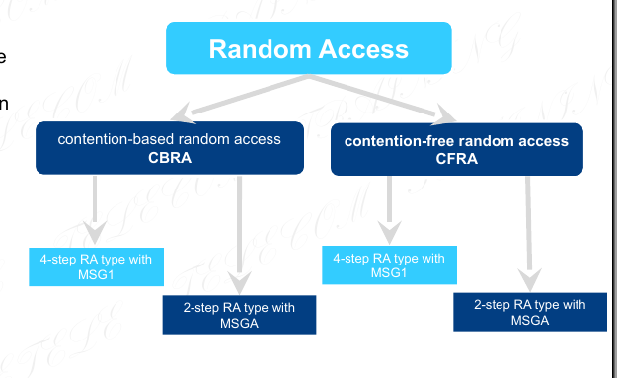

Slide 18
Key Challenges and solutions
Challenges-
High Traffic and Congestion:- Large number of devices accessing the network simultaneously.
Low latency Requirements:-5G's ultra-low latency requirements make RAP delays critical.
Security Threats:- Warning: -Vulnerable to cyber attacks and unauthorized access.
Scalability:- Handling the increasing network traffic and growing number of devices.
Interface Management:- Managing interference from multiple devices accessing the network.

Slide 19
Key Challenges and solutions
Solutions:-
Enhanced Contention Resolution Algorithms:- Improving collision resolution to reduce delays.
Dedicated RAP Channels: Allocating separate channels for RAP to reduce congestion.
Security Enhancements: Implementing advanced security measures, such as encryption and authentication.
RAP Optimization: Optimizing RAP parameters, such as preamble selection and transmission power.
Edge Computing: Processing RAP at the edge to reduce latency and improve performance.

Slide 20
Real-World Applications
Smart Cities: RAP supports smart city applications, like intelligent transportation systems, smart energy management, and public safety.
Autonomous Vehicles: RAP enables vehicle-to-everything (V2X) communications, critical for autonomous vehicles' safety and navigation.
Public Safety: RAP enables mission-critical communications for public safety agencies, such as police, fire, and ambulance services.
Smart Homes: RAP enables smart home applications, such as home automation, security systems, and voice assistants.
Cellular Networks: RAP is used in cellular networks for initial access, handover, and connection re-establishment.
Public Wi-Fi and Hotspot:-When we connect to a public Wi-Fi network or hotspot, the RAP helps your device get a connection quickly, even in crowed area with many other users.

Slide 21
Code

Slide 22

Conclusion
Efficient Access:- Random access procedures are essential for efficient and fair access to shared communication channels.
Improve Performance:- They contribute to improved network performance, enabling faster data transfer and reduced latency.
Key for Modern Network:- Random access procedures are crucial for the operation of modern wireless and wired networks.

Slide 23
Thank you

